Slide 1
École Polytechnique de Montréal
Paper Presentation
2026.07.20 Meeting
Participant: Justin, Anum
MITACS Research Meeting · 2026
Quantum Computing and Genetic Algorithms for Software Testing

Slide 2
1
Paper 1 · Transfer Learning in Hybrid Classical–Quantum Neural Networks

Slide 3
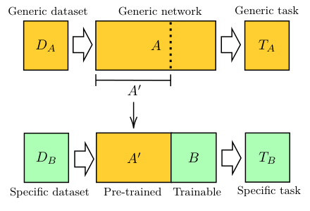
1 · MOTIVATION
Why classical pre-processing is needed
Use a mature classical network to make quantum input small
Problem
Idea
Goal
Raw images are high-dimensional, while near-term quantum devices only support a small number of stable qubits.
Do not encode raw pixels. First use a pre-trained classical CNN to extract informative visual features.
Demonstrate classical-to-quantum transfer learning on simulators and real NISQ processors.
Task definition
A pre-trained network A is truncated into a fixed feature extractor A′. A smaller trainable block B is attached for the new task. In the CQ case, B is a dressed quantum circuit.
Fig. 1: transfer-learning workflow
Key idea: high-dimensional data are handled classically; the quantum circuit receives only a compact feature vector.
MITACS Research Meeting
Transfer learning in hybrid classical-quantum neural networks
3
Notes:
This paper is not trying to show quantum advantage. It shows that transfer learning can be moved across the classical-quantum boundary. The key for our topic is that a classical model compresses the high-dimensional image before quantum encoding.

Slide 4
1 · DATA AND MODELS
Dataset, feature extractor, quantum block
What data do they use, and what does each model do?
Pre-training source
Target dataset
Quantum block
ImageNet: a public dataset with 1,000 image classes. ResNet18 is first trained to recognize general visual patterns.
Hymenoptera subset: ants vs. bees. 245 training images and 153 test images. They also test restricted CIFAR-10 tasks.
A 4-qubit dressed quantum circuit: classical 512→4 layer, variational quantum circuit, and classical 4→2 layer.
1
Raw image
2
ResNet18
3
Linear layer
4
VQC
RGB pixel array
→
512 abstract features
→
512 → 4 values
→
4-qubit classifier
Data meaning
The four quantum inputs are not raw pixels. They are task-adapted high-level visual features learned through ResNet and a trainable classical layer.
MITACS Research Meeting
Transfer learning in hybrid classical-quantum neural networks
4

Slide 5
1 · PREPROCESSING
Classical image → usable classical feature vector
The key encoding preparation happens before the quantum circuit
Raw data
Feature extraction
Compression to qubits
Each sample is an image: RGB pixel intensities arranged in height × width × 3 dimensions.
Truncated ResNet18 removes the final layer and outputs a 512-dimensional feature vector.
A trainable classical layer maps 512 features to 4 numbers, matching the 4 available qubits.
image X → ResNet18 without final layer → h ∈ R⁵¹² → trainable linear layer → z ∈ R⁴
Why this matters
Limitation
The quantum computer only sees four learned features. This makes high-resolution image processing feasible on 4 qubits.
The representation is label-driven: ResNet was trained on ImageNet labels and the last layers are optimized for classification.
MITACS Research Meeting
Transfer learning in hybrid classical-quantum neural networks
5

Slide 6
1 · QUANTUM ENCODING
Compressed vector → 4-qubit state
How the four features become quantum data
Encoding formula
Interpretation
For z = [z₁,z₂,z₃,z₄], each feature controls one qubit:
|Φ(z)⟩ = ⊗ₖ Rᵧ(πzₖ/2)H|0⟩
This is angle encoding: one compressed classical value becomes one rotation angle on one qubit.
q₁
z₁
q₂
z₂
q₃
z₃
q₄
z₄
Rᵧ(πz₁/2)H|0⟩
Rᵧ(πz₂/2)H|0⟩
Rᵧ(πz₃/2)H|0⟩
Rᵧ(πz₄/2)H|0⟩
VQC layer
Measurement
Output
Trainable Rᵧ rotations plus CNOT entanglement process the encoded features.
Pauli-Z expectations are read out from the qubits as classical values.
A final classical layer maps 4 measured values to 2 class logits.
MITACS Research Meeting
Transfer learning in hybrid classical-quantum neural networks
6

Slide 7
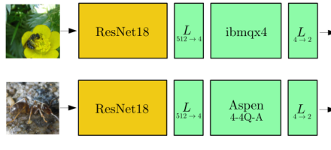
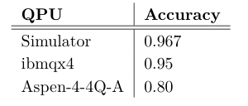
1 · EXPERIMENT
Simulation and real-hardware proof of concept
How they test the compressed-feature quantum model
Training
Quantum depth
Hardware
Cross-entropy loss, Adam optimizer, 30 epochs for ants/bees, batch size 4, learning rate starts at 0.0004.
The ants/bees experiment uses a 4-qubit circuit with depth 6. The ResNet feature extractor is fixed.
The same trained model is executed on IBM ibmqx4 and Rigetti Aspen with 1024 shots per expectation.
Fig. 4: ResNet + 4-qubit hardware pipeline
Table 2: simulator and hardware accuracy
Experiment design: keep classical feature extraction strong, then test whether a small quantum head can be attached.
MITACS Research Meeting
Transfer learning in hybrid classical-quantum neural networks
7

Slide 8
1 · RESULTS
What this paper shows for your topic
Classical compression is feasible, but not anomaly-preserving yet
Main result
Main contribution
Main limitation
Ants/bees accuracy: simulator 0.967, IBM ibmqx4 0.95, Rigetti Aspen 0.80.
A high-dimensional image can be reduced to 4 informative features and classified by a 4-qubit quantum circuit.
The compression is supervised and transfer-learned; it does not test whether unseen anomaly information is preserved.
Takeaway for our research
This paper is a strong baseline for “classical feature extractor + quantum model.” But for anomaly detection, we need a normal-only compressor that does not collapse unknown anomalies into normal-looking features.
Known result: classical pre-processing can solve the qubit bottleneck. Open issue: does it preserve unknown anomalies?
MITACS Research Meeting
Transfer learning in hybrid classical-quantum neural networks
8

Slide 9
2
Paper 2 · Hybrid Quantum Classical Classifier Based on Tensor Network and VQC

Slide 10
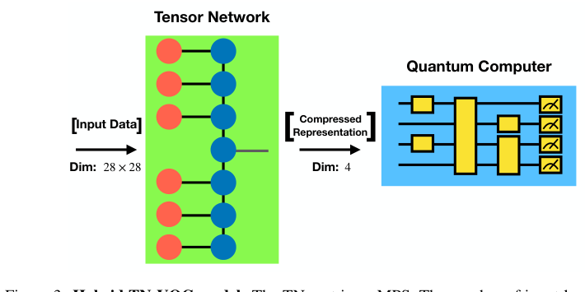
2 · MOTIVATION
Why PCA is not enough
Make classical compression trainable and compatible with the quantum classifier
Problem
PCA limitation
Paper’s idea
High-dimensional inputs cannot be directly embedded in shallow NISQ circuits without too many qubits or too much depth.
PCA is fixed and unsupervised: it keeps high-variance directions, not necessarily task-useful or VQC-useful information.
Use a trainable Matrix Product State as feature extractor and optimize it end-to-end with the VQC.
Research definition
Can a quantum-inspired tensor network produce a better four-dimensional input for a VQC than PCA?
Fig. 3: MPS compresses MNIST to dimension 4
Key novelty: the classical compressor and quantum classifier are trained together, not separately.
MITACS Research Meeting
Hybrid TN-VQC classifier
10

Slide 11
2 · DATASET
What data did they use?
MNIST binary classification: digit 3 vs. digit 6
Raw data
Data meaning
Task
MNIST grayscale images, 28×28 pixels. Each sample is flattened to x ∈ R⁷⁸⁴.
Each feature is a normalized pixel intensity in [0,1], representing ink darkness at one image location.
Supervised binary classification: predict whether the image is digit 3 or digit 6.
image 28×28 → flatten → x = [x₁,…,x₇₈₄] → normalize each pixel to [0,1]
Why this dataset is useful
It is simple enough to benchmark, but still high-dimensional enough to expose the quantum encoding bottleneck.
MITACS Research Meeting
Hybrid TN-VQC classifier
11

Slide 12
2 · PREPROCESSING
Classical image → compressed MPS representation
The tensor network turns 784 pixels into 4 values
Pixel feature map
MPS contraction
Output
Each pixel xᵢ is mapped to [cos(πxᵢ/2), sin(πxᵢ/2)].
The feature-mapped pixels are contracted with a Matrix Product State.
The MPS produces z ∈ R⁴, the compact vector for the VQC.
x ∈ R⁷⁸⁴ → tensor feature map → trainable MPS → z = [z₁,z₂,z₃,z₄]
Important clarification
Compression control
The tensor feature map looks quantum-like, but it is computed classically. It does not require 784 qubits.
MPS bond dimension χ controls representation power. Larger χ can model more correlations but may overfit.
MITACS Research Meeting
Hybrid TN-VQC classifier
12

Slide 13
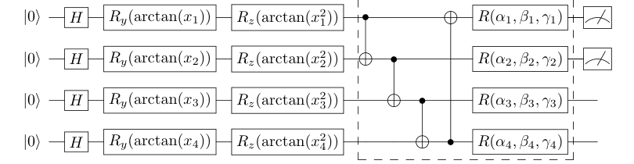
2 · QUANTUM ENCODING
Four MPS features → four qubits
VQC encoding uses arctangent rotations
Encoding per feature
qᵢ: |0⟩ → H → Rᵧ(arctan(zᵢ)) → R𝓏(arctan(zᵢ²))
Why arctan?
The MPS output can be any real number. arctan maps it into a bounded rotation angle.
Fig. 4: VQC encoding and trainable block
Variational block
Measurement
End-to-end
CNOT gates entangle qubits; R(α,β,γ) gates are trainable single-qubit unitaries.
The first two qubits are measured to produce binary classification outputs.
Gradients update both MPS parameters and VQC parameters in the same training loop.
Encoding is shallow because the MPS has already reduced 784 pixels to only 4 numbers.
MITACS Research Meeting
Hybrid TN-VQC classifier
13

Slide 14
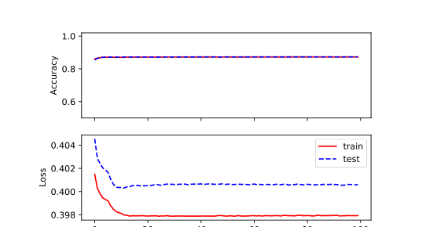
2 · EXPERIMENT
How they test MPS compression
Compare PCA–VQC, MPS alone, and MPS–VQC
Baseline: PCA–VQC
Ablation: MPS only
Main model: MPS–VQC
784 pixels → PCA → 4 features → same VQC. Optimized with RMSProp.
MPS acts as full classifier. Shows representation power and possible overfitting.
MPS produces 4 features; VQC classifies; both are trained end-to-end.
MITACS Research Meeting
Hybrid TN-VQC classifier
14

Slide 15
2 · RESULTS
What the TN–VQC paper shows
Learned compression beats fixed PCA in this task
PCA–VQC
MPS–VQC
Regularization
Testing accuracy: 87.34%. PCA gives a valid four-dimensional input but loses task-relevant structure.
Testing accuracy: 99.44% with χ = 1. The learned compressor is much stronger than PCA here.
When MPS alone overfits at χ = 2, adding the VQC stabilizes test loss.
Takeaway for our research
The classical compressor should not be treated as a neutral preprocessing step. Its training objective and its connection to the quantum circuit strongly determine performance.
Open issue for anomaly detection: end-to-end supervised compression may discard information needed for unknown anomalies.
MITACS Research Meeting
Hybrid TN-VQC classifier
15

Slide 16
3
Paper 3 · Enhancing VQCs with Hybrid Autoencoders

Slide 17
3 · MOTIVATION
PCA may not match the quantum feature map
Dimensionality reduction should know how the data will be embedded
Problem
PCA issue
Paper’s proposal
Angle encoding usually needs one qubit per feature, so high-dimensional data must be reduced first.
PCA preserves classical variance, but the downstream VQC sees quantum-state similarity, not Euclidean variance.
Build a compressor whose bottleneck contains the same quantum feature map used later by the VQC.
PQAE
QAE in this paper
Hybrid preprocessor: classical encoder → quantum feature map → quantum kernel KPCA → classical decoder.
A quantum-inspired classical autoencoder using SU(n) exponential maps. It is not the trash-qubit QAE.
Closest to your topic: PQAE trains compression with the downstream quantum embedding in the loop.
MITACS Research Meeting
Enhancing VQCs with hybrid autoencoders
17

Slide 18
3 · DATASETS
What data do they compress?
Four classical datasets with different feature dimensions
Iris
Wine
Seed
MNIST
N = 4 flower measurements: sepal/petal length and width. Classification of species.
N = 13 chemical features such as alcohol, acidity, magnesium, flavanoids.
N = 7 wheat-kernel geometric measurements: area, perimeter, compactness, etc.
N = 64 pixel features from 8×8 handwritten digits.
Data meaning
Experimental goal
Unlike images in Paper 1 or full MNIST in Paper 2, these datasets are already structured classical feature vectors.
Reduce each dataset to 4 qubit-compatible features, then compare VQC accuracy using PCA/raw encoding versus PQAE encoding.
Main setting: N-dimensional classical vector → four values → four-qubit ZZFeatureMap.
MITACS Research Meeting
Enhancing VQCs with hybrid autoencoders
18

Slide 19
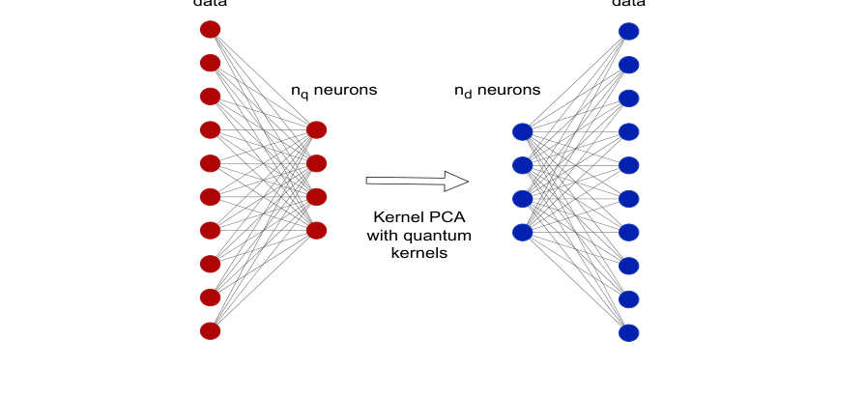
3 · PQAE PIPELINE
Classical data → quantum-kernel-aware representation
The most relevant encoding method in this paper
Step 1
Classical linear encoder maps x ∈ Rᴺ to z ∈ Rⁿᵩ, where nᵩ is the number of qubits.
Step 2
The z values are passed through the same data-embedding circuit that the VQC will use later.
Fig. 2: PQAE model
Step 3
Quantum kernels are estimated and used for KPCA; the decoder reconstructs the original vector.
Kᵢⱼ = |⟨ψᵢ|ψⱼ⟩|²
Loss
MSE(x, x̃)
PQAE is unsupervised: it optimizes reconstruction, not classification labels.
MITACS Research Meeting
Enhancing VQCs with hybrid autoencoders
19

Slide 20
3 · QUANTUM ENCODING
PQAE uses the downstream VQC feature map
Why it is more quantum-aware than PCA
VQC setup
Feature map
Variational block
For Iris, Wine, Seed, and MNIST, they use a 4-qubit VQC with Qiskit ZZFeatureMap and RealAmplitudes ansatz.
The 4 compressed values are embedded by ZZFeatureMap with 2 repetitions, including feature interactions.
RealAmplitudes ansatz with 3 repetitions is trained for classification.
x ∈ Rᴺ → PQAE encoder → z ∈ R⁴ → ZZFeatureMap → |ψ(z)⟩ → RealAmplitudes VQC
Core intuition
Practical concern
PCA selects directions before seeing the quantum feature map. PQAE learns a compressed representation aligned with the quantum feature space.
Quantum-kernel estimation requires M×M pairwise state overlaps per batch, which may be costly.
MITACS Research Meeting
Enhancing VQCs with hybrid autoencoders
20

Slide 21
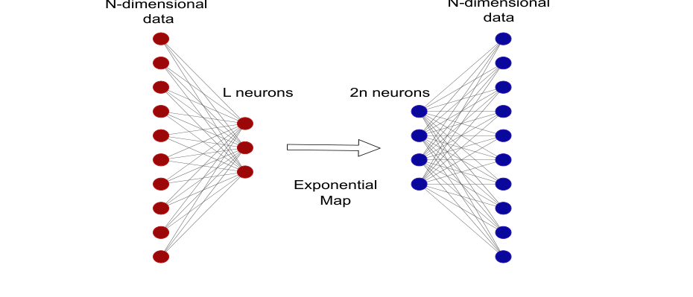
3 · QAE VARIANT
Quantum-inspired autoencoder in the same paper
Useful idea, but not the same as a quantum autoencoder
What it does
A classical AE bottleneck is replaced by a quantum-inspired exponential map.
Mathematical idea
Reduced features parameterize an SU(n) unitary: U(z)=exp(−iΣ zⱼGⱼ).
Important distinction
This model runs on classical hardware. It does not prepare qubits or use trash states.
For your research, PQAE is the closer prior work; this QAE is more of a quantum-inspired AE baseline.
MITACS Research Meeting
Enhancing VQCs with hybrid autoencoders
21

Slide 22
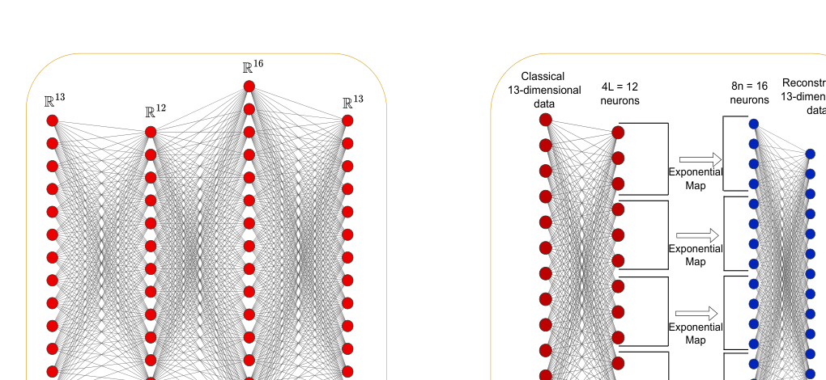
3 · RESULTS
Does quantum-aware compression help?
PQAE improves three of four VQC classification tasks
Iris
Wine
Seed
MNIST
Raw/PCA: 0.77
PQAE: 0.97
PCA: 0.56
PQAE: 0.83
PCA: 0.57
PQAE: 0.74
PCA: 0.82
PQAE: 0.81
Fig. 5: classical AE vs batched QAE on Wine
Result nuance: PQAE helps most tabular tasks, but it does not universally beat PCA.
MITACS Research Meeting
Enhancing VQCs with hybrid autoencoders
22

Slide 23
3 · RELEVANCE
Why this paper matters for your topic
It directly studies compression before quantum encoding
Strongest match
Useful concept
Remaining gap
PQAE explicitly asks how to compress classical data before sending it through a VQC feature map.
Compression should be aware of the downstream quantum embedding, not only classical reconstruction or variance.
The paper studies supervised classification, not normal-only anomaly detection or trash-fidelity QAE.
Takeaway for our research
This is the closest prior work, but the open question remains: can such a compressor preserve unseen anomaly information while also reducing real quantum resource cost?
Research opportunity: anomaly-preserving, QAE-aware, hardware-aware compression.
MITACS Research Meeting
Enhancing VQCs with hybrid autoencoders
23

Slide 24
4 · SYNTHESIS
What the three papers have in common
All three solve the same bottleneck with different compression strategies
Paper
Quantum encoding
Training style
Transfer learning
ResNet18 → 512 → 4
Rᵧ angle encoding
Frozen CNN + train quantum head
TN–VQC
MPS: 784 pixels → 4
Rᵧ(arctan z), R𝓏(arctan z²)
End-to-end supervised
PQAE
AE + quantum kernel KPCA → 4
ZZFeatureMap
Unsupervised pretraining + classifier
Same motivation
Different solution
Shared limitation
Qubit count and circuit depth make direct high-dimensional encoding impractical.
They differ in how the compressed representation is learned: pretrained, end-to-end, or quantum-feature-aware.
None directly solves normal-only anomaly-preserving compression for a downstream QAE.
Conclusion: “compress before quantum encoding” is established; the unsolved part is how to compress without hiding anomalies.
MITACS Research Meeting
Classical Compression Before Quantum Encoding
24

Slide 25
4 · SYNTHESIS
Key differences for research positioning
Which parts can be reused, and which gaps remain?
Can reuse
Cannot directly reuse
Need to add
Feature extractor + quantum head; end-to-end hybrid training; quantum-feature-map-aware preprocessing.
Their objectives are mostly supervised classification or input reconstruction, not unseen-anomaly preservation.
Evaluation of anomaly separation, quantum resources, encoding depth, two-qubit gates, shots, and noise robustness.
Existing literature: high-dimensional data → compressed features → VQC
Your gap: normal-only compression → anomaly-preserving features → QAE anomaly score
The new contribution should be evaluated on both detection quality and quantum hardware cost.
MITACS Research Meeting
Classical Compression Before Quantum Encoding
25

Slide 26
5 · RESEARCH TOPIC
Proposed definition
Anomaly-preserving compression before quantum encoding
Proposed title
Anomaly-Preserving and Hardware-Aware Classical Compression for Quantum Autoencoder Anomaly Detection
high-dimensional classical data → normal-only compressor → low-dimensional features → shallow quantum encoding → QAE trash-fidelity score
Core question
Compression goal
Quantum goal
Can we reduce quantum encoding resources without destroying unseen anomaly information?
Learn compact normal structure, but keep deviations visible to the QAE.
Reduce qubits, depth, CX count, shots, and noise sensitivity.
MITACS Research Meeting
Classical Compression Before Quantum Encoding
26

Slide 27
5 · RESEARCH PLAN
How the topic can be tested
Ablation study for compression, encoding, and anomaly detection
Compression baselines
Quantum encodings
QAE detector
PCA, random projection, classical AE, TCN/1D-CNN encoder, and quantum-aware AE/PQAE-style encoder.
Angle encoding, dense-angle encoding, data re-uploading, and shallow amplitude/quasi-amplitude variants.
Train on normal-only data and use trash fidelity or direct trash measurement as anomaly score.
Performance metrics
Resource metrics
Critical ablation
AUROC, AUPRC, detection delay, false-positive rate, and score calibration.
Qubit count, transpiled depth, two-qubit gate count, shots, runtime, and hardware/noise robustness.
Compressed data + classical detector vs. compressed data + QAE, to prove the quantum part adds value.
Final research claim should be about the trade-off: anomaly information retained per unit of quantum resource.
MITACS Research Meeting
Classical Compression Before Quantum Encoding
27

